Slide 1

Federated Portal for Finance Forums
CS 410 Text Retrieval and Mining
MCSDS Course Final Project
Gayatri Balakrishnan(gayatri3)

Slide 2
Objective
There are many online forums related to finance and personal investments.
Current forums are all scattered on the Internet with little connection to each other, leading to many isolated fragmented communities on similar topics
This project seeks to leverage the idea of Federated Forum Portal and apply it specifically to finance and personal investment forums.
This project expects to leverage the concepts and methods described in Prof.Cheng’s post on Federated Forums and apply them in creating a Federated Portal model for the personal finance domain that would help users in finding the appropriate forums and in collating information posted on similar threads across the same or different forums.

Slide 3
High Level Approach
The proposal is to
build a web crawler for a finance-related forum
build an inverted index and topic model to enable topic map construction
rank topics using the topic model in conjunction with user demographics, freshness of the posts and number of participants.
create a visualization interface showing the user trending topics in the personal finance area

Slide 4
Steps to execute
Prerequisites:
Must have Python, Jupyter (for reading and executing IPython Notebooks), Scrapy Web_Crawling Framework and Scikit-Learn installed.
Steps:
Part 1: Crawl the website and get the forum threads
1. Create a project using the below command:
scrapy startproject cs410fedforum
2. Copy the file finance_spider.py into the cs410fedforum/spiders folder
3. Go to the project’s top level directory and run:
scrapy crawl financeforums -o financetopics.json

Slide 5
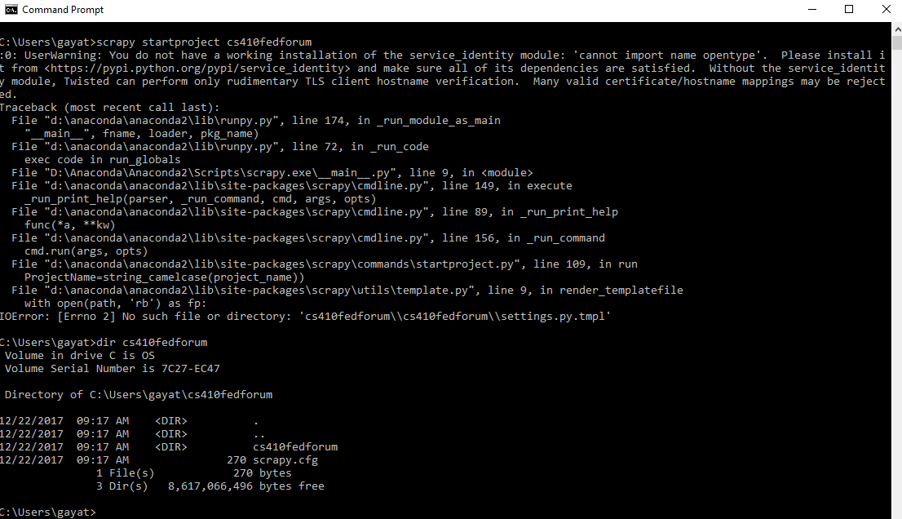
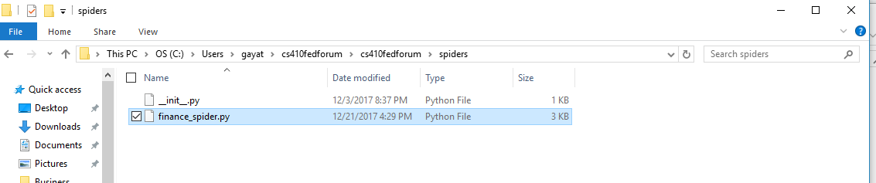
Demo Screenshots
Part 1: Crawl the website and get the forum threads

Slide 6
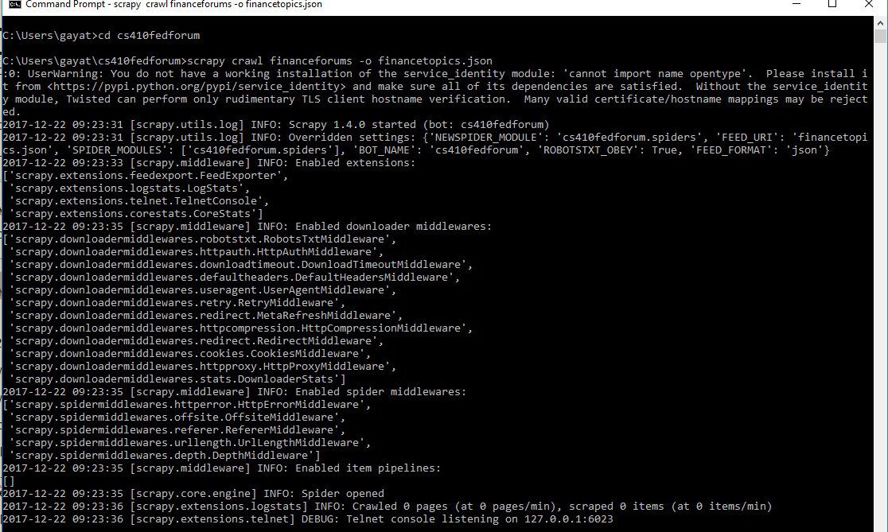
Demo Screenshots
Part 1: Crawl the website and get the forum threads

Slide 7
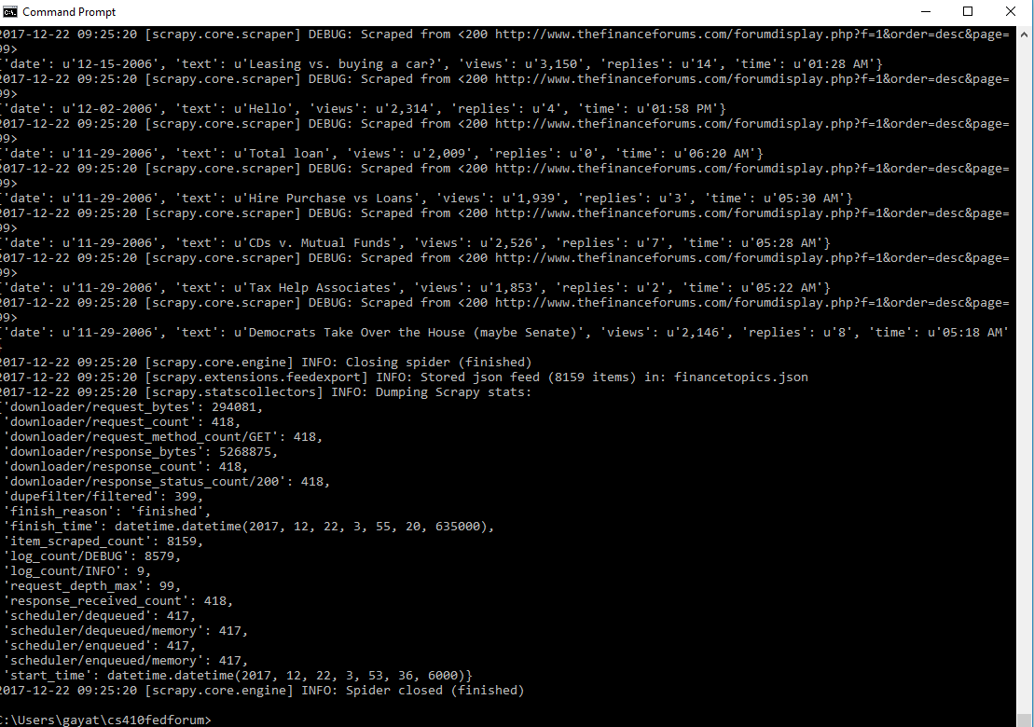
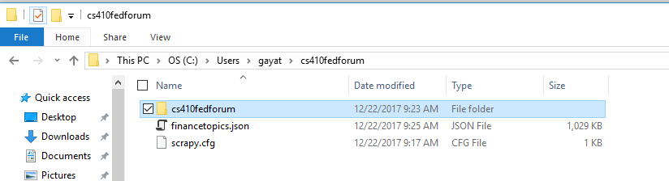
Demo Screenshots
Part 1: Crawl the website and get the forum threads

Slide 8
Steps to execute
Part 2: Training the classifier
1. Download the data directory which contains the training data for categories
2. Download the CS410FedForums-Categorization IPython notebook
3. Copy the json file financetopics.json from Part 1 above to the same path as the CS410FedForums-Categorization IPython notebook
4. In the CS410FedForums-Categorization IPython notebook, replace the path of the data directory in the first parameter of load_files on this line:
docs_to_train = sklearn.datasets.load_files("C:\Users\gayat\ipythonnotebooks\data", description=None, categories=None, load_content=True, shuffle=True, encoding='utf-8', decode_error='strict', random_state=0)
5. In the CS410FedForums-Categorization IPython notebook, replace the path in this line with wherever you want the output file to be created:
filename="C:\Users\gayat\ipythonnotebooks\categorization_output.txt"
6. Run the CS410FedForums-Categorization IPython notebook.
Note: See Deep Dive section for a brief description of how the prediction accuracy was evaluated

Slide 9
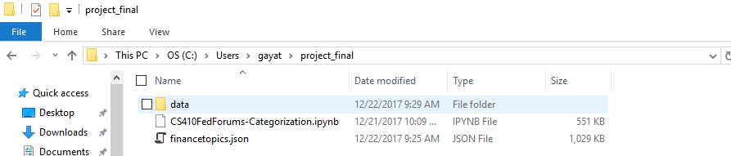
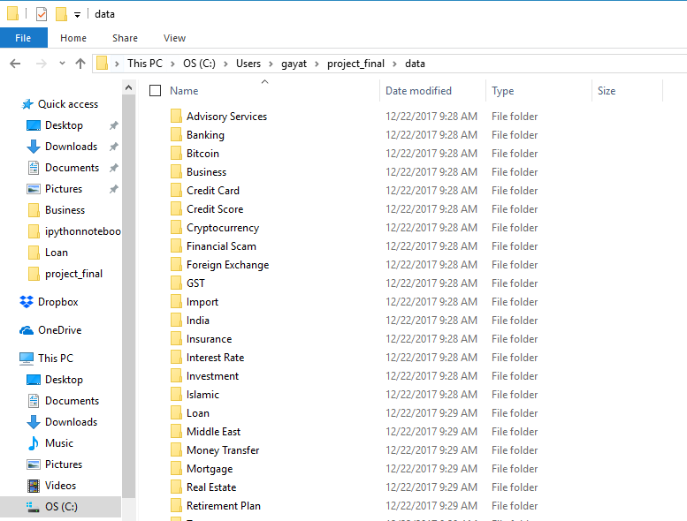
Demo Screenshots
Part 2: Training the classifier

Slide 10
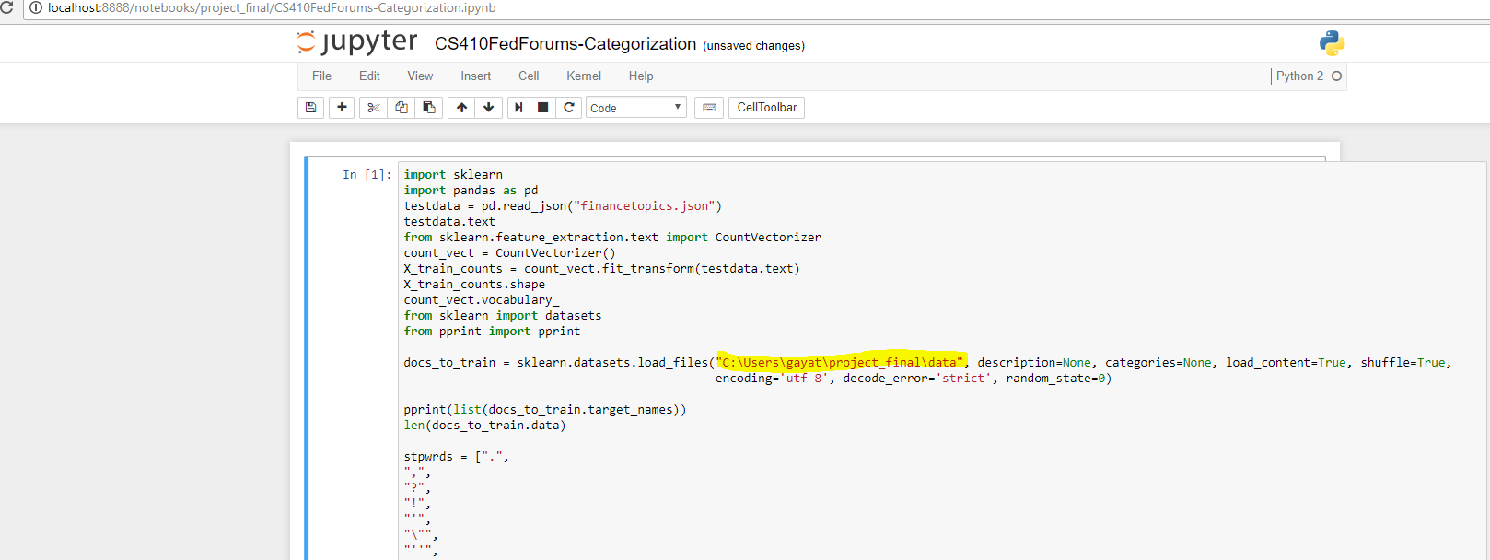
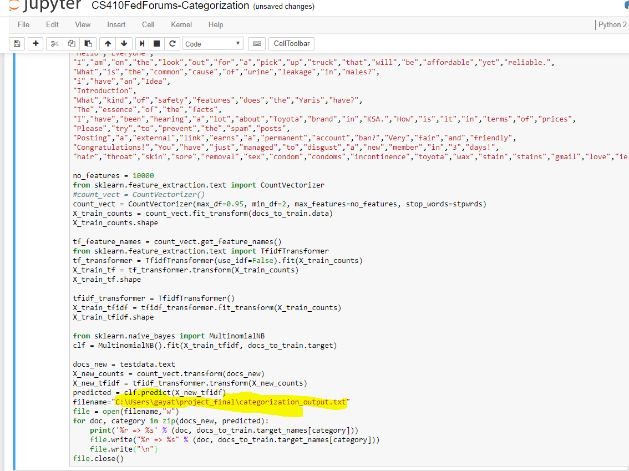
Demo Screenshots
Part 2: Training the classifier

Slide 11
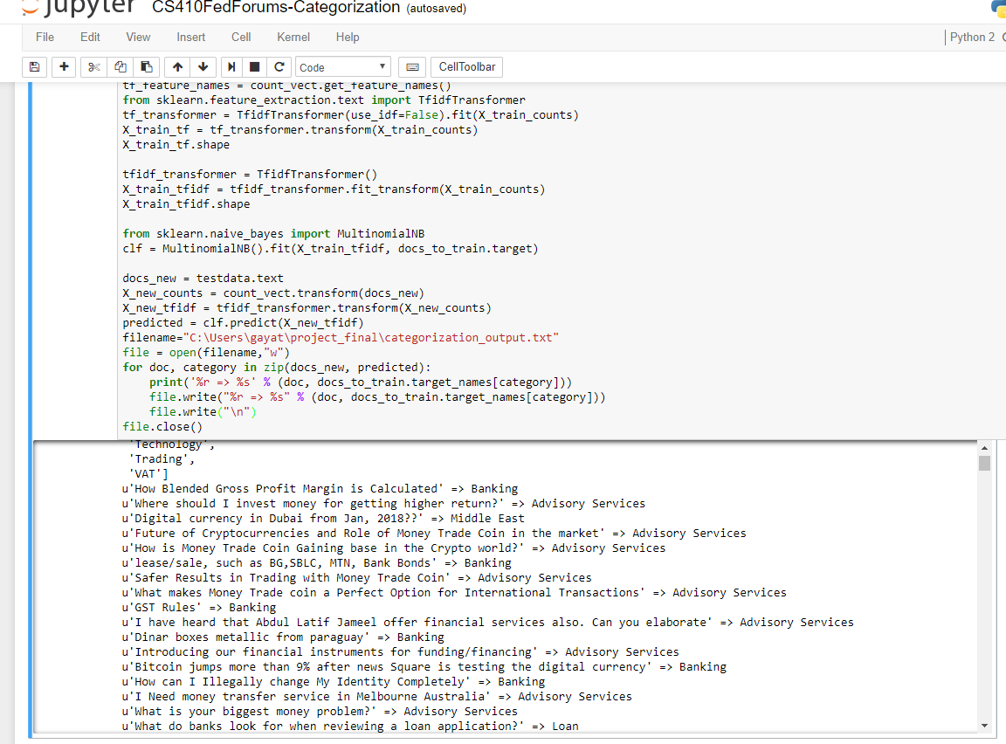
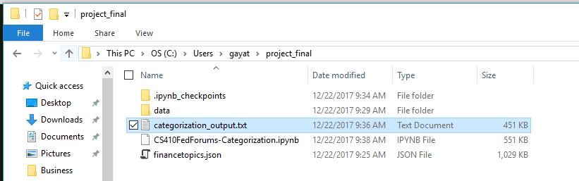
Demo Screenshots
Part 2: Training the classifier

Slide 12
Steps to execute
Part 3: Creating the Topic Map
1. Download the NMF_LDA_TopicMap IPython notebook.
2. Copy the json file financetopics.json from Part 1 above to the same path as the NMF_LDA_TopicMap IPython notebook.
3. In the NMF_LDA_TopicMap IPython notebook, replace the path in this line with wherever you want the output file to be created:
filename="C:\Users\gayat\ipythonnotebooks\output.txt"
4. Run the NMF_LDA_TopicMap IPython notebook

Slide 13
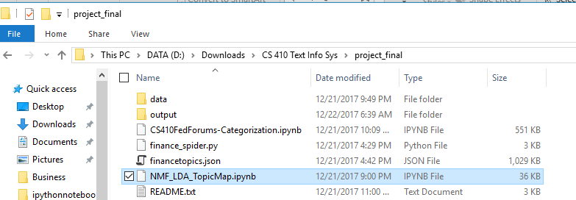
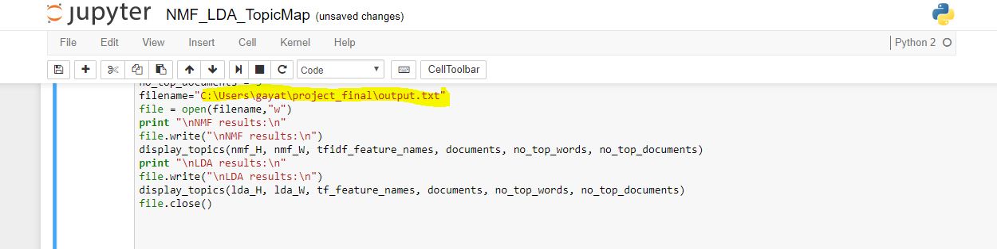
Demo Screenshots
Part 3: Creating the Topic Map

Slide 14
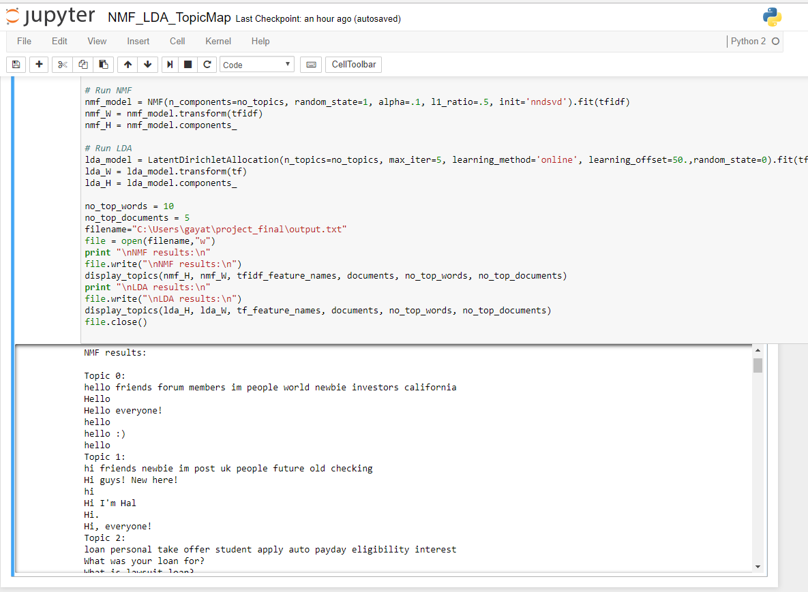
Demo Screenshots
Part 3: Creating the Topic Map

Slide 15
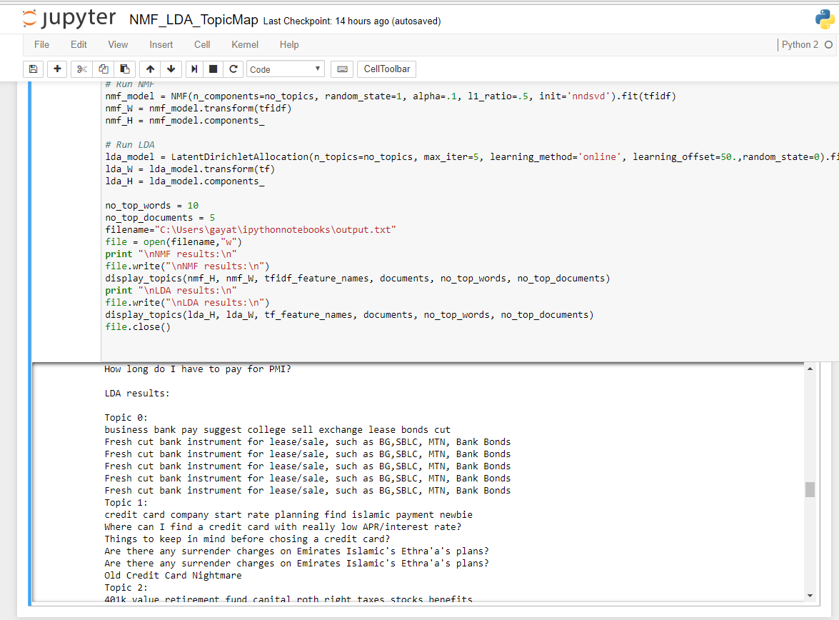
Demo Screenshots
Part 3: Creating the Topic Map

Slide 16
Steps to execute
Part 4: Visualization of the data
The json file from Part 1 above was used to create a quick visualization of top trending forum threads by views, replies and dates. This visualization is available here:
https://public.tableau.com/profile/gayatri.balakrishnan#!/vizhome/CS410FederatedForumsVisualization/MostPopularandMostViewedThreadsbyYear
https://public.tableau.com/profile/gayatri.balakrishnan#!/vizhome/CS410FederatedForumsVisualization/MostViewedThreads
https://public.tableau.com/profile/gayatri.balakrishnan#!/vizhome/CS410FederatedForumsVisualization/MostPopularThreads

Slide 17
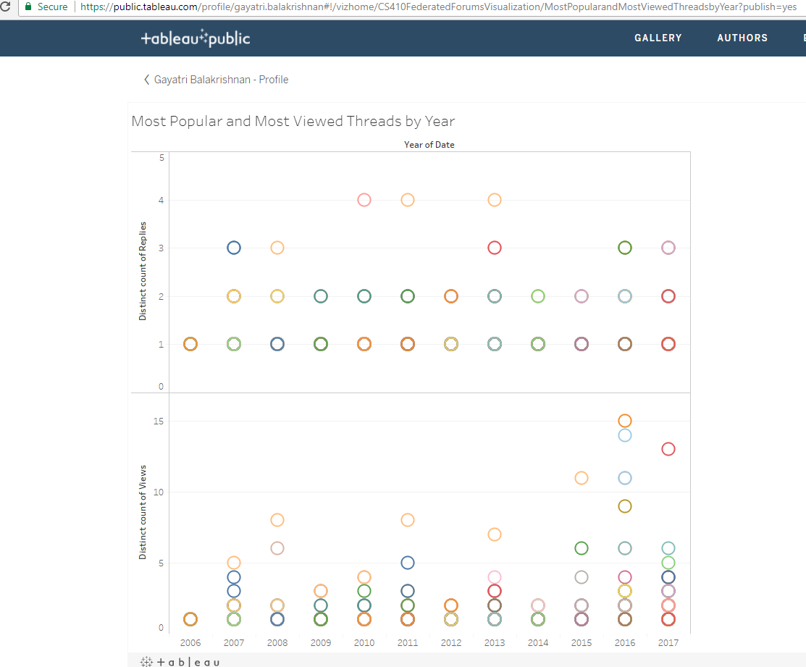
Demo Screenshots
Part 4: Visualization of the data

Slide 18
Deep Dive & Learnings

Slide 19
Part 1: Crawl the websites to get the forum threads
The dataset for this project consists of the forum threads along with metrics that would help evaluate popularity and freshness of posts.
Used the Scrapy framework and XPath selectors
Why Scrapy?
Had evaluated Scrapy, Crawly and Crawley web crawling frameworks
found Scrapy to be really useful
a rich set of features, with a focus on ease of use and efficiency.
a very active community.
Recommended for both newbies and experts looking to use web crawlers in their text analysis applications.
In the financeforums.com website,
crawled the first page of all subforums to get the training dataset of threads
crawled the General Finance forum threads that span over 10 years. Extracted thread titles, number of views, number of replies and last updated time.
Similarly other forums can be crawled as well.

Slide 20
Part 1: Building a web crawler-Learnings
Using the Robots Exclusion Protocol, many websites disallow crawlers. These include some forums like savingadvice.com. We check the robots.txt page in the website we are visiting to determine whether and what crawling is allowed.
Careful throttling of crawling speed and design of XPath selectors to avoid a DOS attack on the crawled website.
Scrapy provides the autothrottle extension to determine optimum crawling speed
Crawling spiders need to be custom built for every site based on the page design. Hence, the crawling spider code in the project cannot be used as is for a website other than http://www.thefinanceforums.com/

Slide 21
Part 2: Training the classifier
In the financeforums.com website, crawled the first page of all subforums to get the training dataset of threads.
Used the scikit-learn package to build the classifier.
Easier to use and Better documentation than MetaPy
Used approach similar to the 20 news groups dataset in scikit-learn tutorial
Training dataset consisted of about 340 threads.
Created a list of stopwords based on training dataset
Manually created a set of 26 broad categories based on training dataset
Used the training dataset to categorize the crawled data from the General Finance subforum
Used the TF-IDF weights and NaiveBayes classifier
Used Cranfield evaluation methodology to evaluate accuracy of the categorization
Based of evaluation of 1% of test dataset (Most recent and popular threads), results were found to be 58% accurate
These results are captured in the Categorization.xlsx file in the output folder.
The finalcat.csv file in the output folder was created using the output of the classifier and the category for the threads from this file was plugged back into Categorization.xlsx

Slide 22
Part 2: Training the classifier-Learnings
Issues with this approach:
Very labor intensive. Manually categorize training data
Data cleaning is mandatory
More than 10% of the training and test datasets were found to be spam threads unrelated to the finance domain
Stopwords had to be customized to prevent classification of spam threads
Further steps in this approach
Try other classifiers and finetune parameters to better the prediction accuracy
In the course assignments, K nearest neighbours seemed to give better classification than NaiveBayes.
As more forums are crawled, expand the stopwords list to filter out spam threads
Can the stopwords list be created as a crowd sourced list?

Slide 23
Part 3: Topic Map construction
Less labor intensive than previous approach described in part 2 above
Stopwords list from part 2 above was reused
Used the scikit-learn package as it is easier to use
Classification and topic map construction based on two approaches
Non-negative Matrix Factorization (NMF)
Latent Dirichlet Allocation (LDA)
Both algorithms take as input a bag of words matrix to produce 2 smaller matrices: a document to topic matrix and a word to topic matrix that when multiplied together reproduce the bag of words matrix with the lowest error.
Lot of research available on both approaches
While NMF relies on linear algebra, LDA is based on probabilistic modeling.
NMF needs a TFIDF Vectorizer to create a bag of words matrix whereas LDA can work with raw counts.

Slide 24
Part 3: Topic Map construction-Learnings
Based on the relevance of the topic maps created by the two approaches, personal preference is LDA.
Both NMF and LDA require us to specify the number of topics to produce.
NMF seems to work better with smaller datasets but LDA is able to get a better topic map even with a larger dataset.
NMF needed a better stopwords list to generate a better topic map with the test dataset.
NMF also seemed to execute slower(by a few seconds) for larger datasets
LDA produced more coherent topics in line with human judgment.
Also corroborated these findings with research papers published in this area (See references)
Further steps in this approach would be
Evaluate topic map accuracy algorithmically
finetune parameters and evaluate accuracy
Try other algorithms and finetune parameters and evaluate topic map accuracy
As more forums are crawled, expand the stop words list to filter out spam threads

Slide 25
Part 4: Visualization of Thread Topics
Simple visualization built using Tableau
Tableau chosen due to ease of use
The initial crawled data consisting of thread titles and metrics was used
Thread Popularity measured based on
freshness of the posts
number of views and replies

Slide 26
Part 4: Visualization of Topics-Learnings
More than 10% of the training and test datasets were found to be spam threads unrelated to the finance domain
This skews the visualization and some irrelevant threads show up as popular
Further steps in this approach
Correlate the topic map and build a visualization of the trending topics instead of just popular threads
As more forums are crawled, add the originating forum information as well
would help users in finding the appropriate forums for their topics of interest
collate information posted on similar threads across the same or different forums
Build the federated forum portal and provide drilldown capability
Try other kinds of visualization
Use other data visualization frameworks like D3.js

Slide 27
References
Prof Cheng’s post on Federated Forums Portal: https://wiki.illinois.edu/wiki/pages/viewpage.action?spaceKey=timanpub&title=Federated+Online+Forum+Portal
Topic Modeling with Scikit-Learn:
https://medium.com/mlreview/topic-modeling-with-scikit-learn-e80d33668730
Scikit-Learn tutorial for training classifier using 20 newsgroups dataset:
http://scikit-learn.org/stable/tutorial/text_analytics/working_with_text_data.html
Scrapy tutorial
https://doc.scrapy.org/en/1.4/intro/tutorial.html#intro-tutorial
The finance forum used to test:
http://www.thefinanceforums.com/
Exploring Topic Coherence over many models and many topics- Keith Stevens, Philip Kegelmeyer, David Andrzejewski, David Buttler, University of California Los Angeles; Lawrence Livermore National Lab, Sandia National Lab
http://aclweb.org/anthology/D/D12/D12-1087.pdf

